Slide 1






LOGOS – COPY & PASTE

Slide 2




STICKERS – COPY & PASTE Let me know if you have any other suggestions

Slide 3


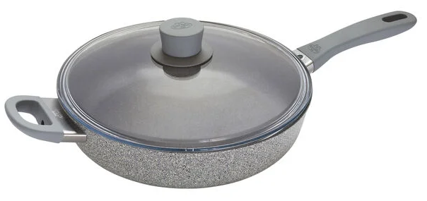
64% OFF
MSRP. $140
NOW $50
BALLARINI Parma Plus
28cm Aluminum Saute Pan
28cm sauté pan: Perfect for browning meat, sautéing vegetables, and cooking sauces.
Granitium coating: Nonstick, scratch-resistant, and metal utensil safe.
Cold-forged aluminum: Ensures even heat distribution and superior retention.
Thermopoint indicator: Color-changing light signals optimal cooking temperature
Item No. 1018388/75003-102

Slide 4
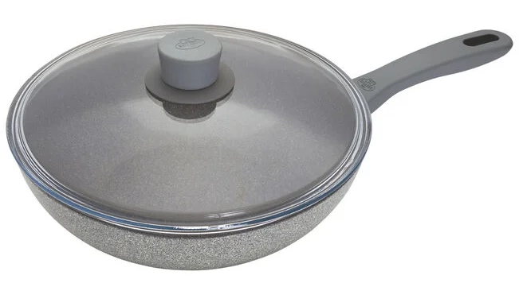
71% OFF
MSRP. $140
NOW $40
BALLARINI PARMA PLUS
28 cm / 11” Aluminum Wok
Design: 11-inch wok with flat bottom, angled sides, and glass lid.
Material: Cold-forged aluminum for even heat distribution.
Nonstick: 3-layer GRANITIUM coating, scratch-resistant, quick release.
Handle: Ergonomic, heat-insulating, ovenproof up to 300°F.
Item No. 1018386/75003-100

Slide 5
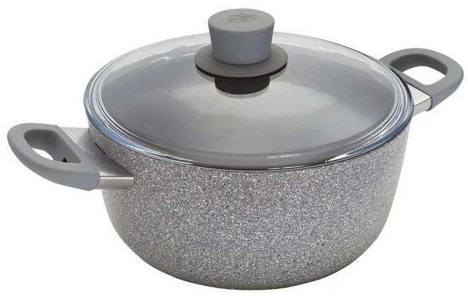
67% OFF
MSRP. $120
NOW $40
BALLARINI Parma Plus
4.5 l Aluminum Stew pot
4.9-quart Dutch oven: Perfect for big batch braising and stewing.
Granitium coating: Nonstick with speckles; scratch-resistant and quick release.
Cold-forged aluminum: Rapid, even heating with excellent heat retention.
Ovenproof: Safe up to 300°F/150°C with an easy-to-clean glass lid.
Item No. 1018384/75003-098

Slide 6
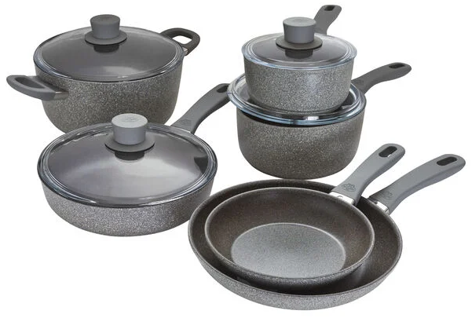
77% OFF
MSRP. $700
NOW $160
BALLARINI Parma Plus
10 Pcs Cookware Set
10-piece set: 8" & 10" fry pans, 1.5-quart & 2.9-quart saucepans with lids, 2.6-quart sauté pan with lid, 4.9-quart Dutch oven with lid.
Granitium coating: Nonstick, scratch-resistant, metal utensil safe.
Thermopoint technology: Color-changing for cooking and cleaning temperatures.
Item No. 1018390/75003-104

Slide 7
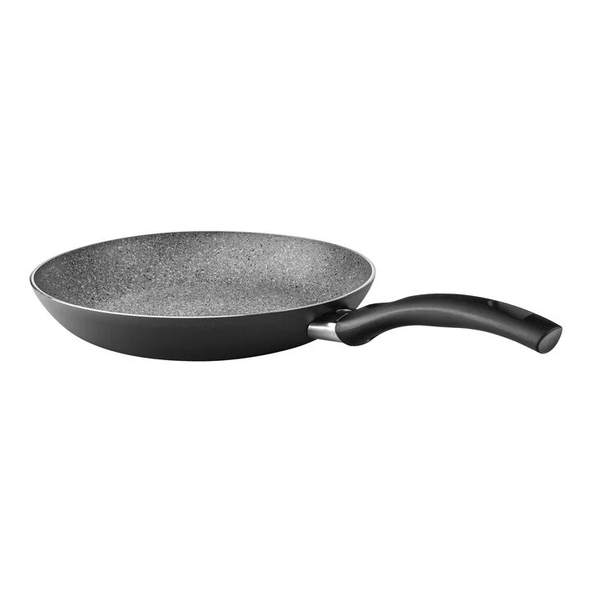
75% OFF
MSRP. $120
NOW $30
BALLARINI BOLOGNA GRANITIUM
28 cm / 11 inch aluminum Frying pan
5x GRANITIUM non-stick coating
With Thermopoint for temperature display
Suitable for all types of hob, including induction
Ergonomic handle
Robust and heat resistant
Item No. 1006545/ 75000-633

Slide 8

71% OFF
MSRP. $140
NOW $40
BALLARINI Bologna Granitium
28 cm aluminum Frying pan
Durable aluminum pan with 5-ply GRANITIUM non-stick coating.
Scratch-resistant and metal utensil safe for low-fat cooking.
Thermopoint handle indicates ideal frying temperature.
Suitable for all hob types, including induction; oven-safe up to 160°C.
Made in Italy.
Item No. 1006547/75000-634

Slide 9
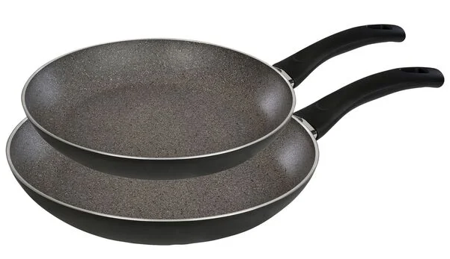
78% OFF
MSRP. $230
NOW $50
Bologna Granitium
2 Pcs Aluminum Pan Set
Handles: Ergonomic, heat-insulating, soft-touch grip.
Nonstick: 5-layer scratch-resistant GRANITIUM coating.
Performance: Quick, even heating on all stovetops, including induction.
Thermopoint: Indicator signals optimal cooking temperature.
Includes: 28 cm and 24 cm pans; oven-proof up to 160°C.
Item No. 1006876/75002-002

Slide 10
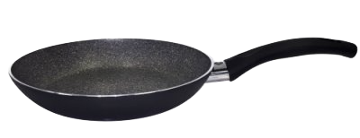
71% OFF
MSRP. $140
NOW $40
BALLARINI BOLOGNA
32cm Granitium Fry Pan Black
Handles: Ergonomic, heat-insulating, soft-touch grip.
Nonstick: 5-layer scratch-resistant GRANITIUM coating.
Performance: Quick, even heating on all stovetops, including induction.
Thermopoint: Indicator signals optimal cooking temperature.
Made in Italy
Item No.
1006547/64240-000-0

Slide 11
73% OFF
MSRP. $110
NOW $30
BALLARINI BOLOGNA
24cm Granitium Fry Pan Black
Handles: Ergonomic, heat-insulating, soft-touch grip.
Nonstick: 5-layer scratch-resistant GRANITIUM coating.
Performance: Quick, even heating on all stovetops, including induction.
Thermopoint: Indicator signals optimal cooking temperature.
Made in Italy
Item No.
1006543/75000-632-0

Slide 12
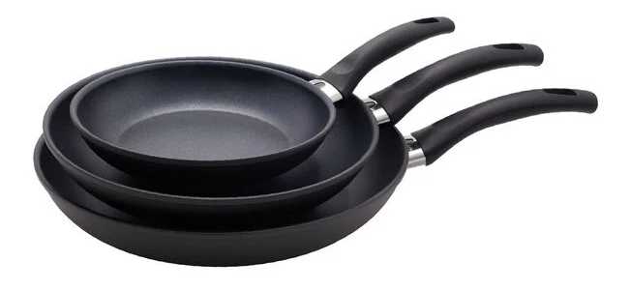
81% OFF
MSRP. $400
NOW $75
BALLARINI Arezzo
3 Pcs Aluminum Pan Set
Nonstick coating: Scratch-resistant PTFE, PFOA-free, for easy release and cleaning.
Thermopoint handle: Color-changing for optimal cooking temperature.
Efficient aluminum: Heats rapidly and evenly; 3 times more energy-efficient than cast iron.
Ergonomic design: Stay-cool handle; dishwasher and oven-safe up to 300°F.
Item No. 1020461

Slide 13
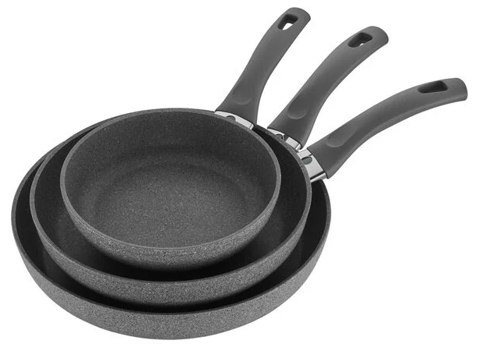
78% OFF
MSRP. $400
NOW $90
BALLARINI Modena
3 Pcs Aluminum Pan Set
Three-pan set: Includes 8", 10", and 12" fry pans.
Granitium coating: Ceramic-infused, PFOA-free, metal utensil safe.
Thermopoint indicator: Color signals for cooking (red) and cleaning (green).
User-friendly features: Mess-free pouring rim and no-slip grip handle.
Item No. 1018295/75002-755

Slide 14
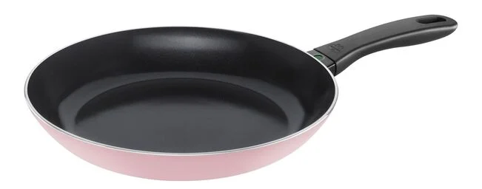
73% OFF
MSRP. $150
NOW $40
BALLARINI Caprera
30cm/12”Aluminum Frying pan
Stylish design: Bright pink frying pan.
KERA GLOSS coating: Non-stick, crispy results.
Radiant induction base: Fast, even heating.
THERMOPOINT indicator: Red means hot.
Induction-compatible.
Item No. 1025115

Slide 15
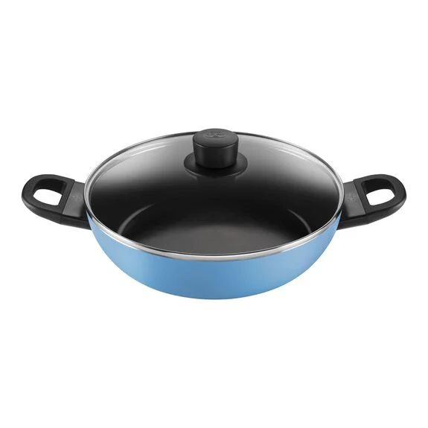
71% OFF
MSRP. $170
NOW $50
BALLARINI Caprera
3.6L SERVING PAN
Stylish design: Bright blue 28" Serving Pan.
KERA GLOSS coating: Non-stick, crispy results.
Radiant induction base: Fast, even heating.
THERMOPOINT indicator: Red means hot.
Induction-compatible.
Item No. 1025110

Slide 16
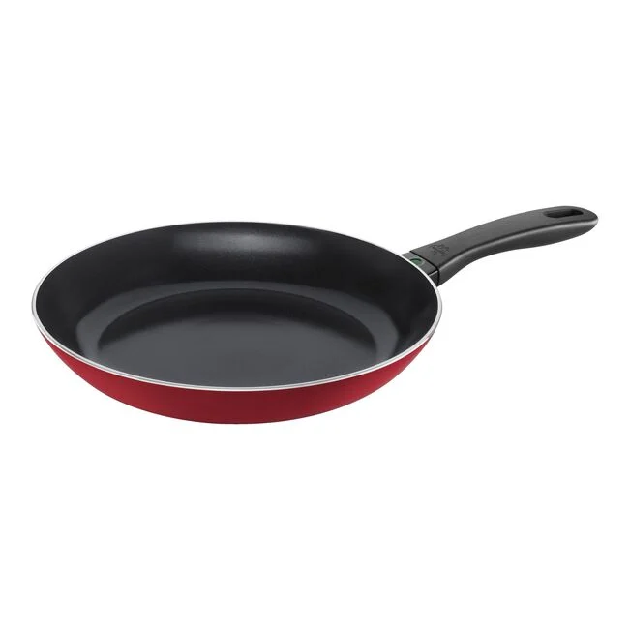
73% OFF
MSRP. $150
NOW $40
BALLARINI Caprera
30cm/12”Aluminum Frying pan
Stylish design: Bright red frying pan.
KERA GLOSS coating: Non-stick, crispy results.
Radiant induction base: Fast, even heating.
THERMOPOINT indicator: Red means hot.
Induction-compatible.
Item No. 1026001

Slide 17
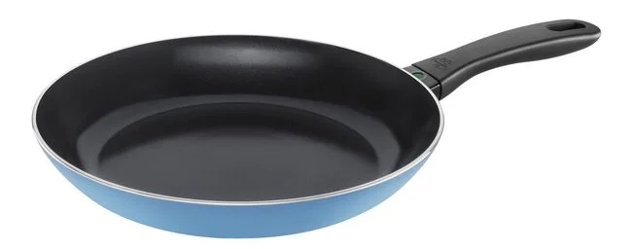
73% OFF
MSRP. $150
NOW $40
BALLARINI Caprera
30cm/12”Aluminum Frying pan
Stylish design: Bright blue frying pan.
KERA GLOSS coating: Non-stick, crispy results.
Radiant induction base: Fast, even heating.
THERMOPOINT indicator: Red means hot.
Induction-compatible.
Item No. 1025109

Slide 18
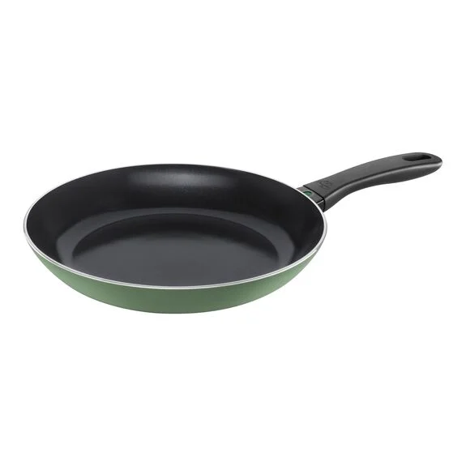
71% OFF
MSRP. $140
NOW $40
BALLARINI Caprera
11”Aluminum Frying pan
Stylish design: Bright green frying pan.
KERA GLOSS coating: Non-stick, crispy results.
Radiant induction base: Fast, even heating.
THERMOPOINT indicator: Red means hot.
Induction-compatible.
Item No. 1024868

Slide 19
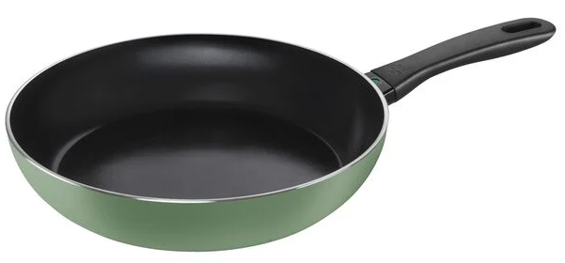
75% OFF
MSRP. $160
NOW $40
BALLARINI Caprera
30cm/12”Aluminum Frying pan
Stylish design: Bright green frying pan.
KERA GLOSS coating: Non-stick, crispy results.
Radiant induction base: Fast, even heating.
THERMOPOINT indicator: Red means hot.
Induction-compatible.
Item No. 1026057

Slide 20
73% OFF
MSRP. $130
NOW $35
BALLARINI Caprera
26cm/10”Aluminum Frying pan
Stylish design: Bright red frying pan.
KERA GLOSS coating: Non-stick, crispy results.
Radiant induction base: Fast, even heating.
THERMOPOINT indicator: Red means hot.
Induction-compatible.
Item No. 1025117

Slide 21
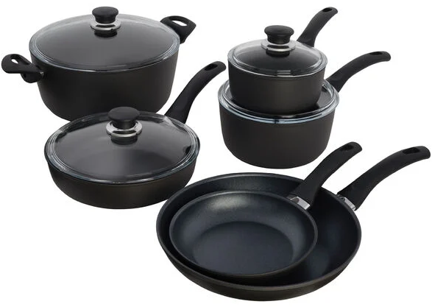
79% OFF
MSRP. $850
NOW $175
BALLARINI Arezzo
10 Pcs Cookware set
GRANITIUM coating: Scratch-resistant, metal utensil safe, and reinforced with ceramic particles.
PFOA-free nonstick coating: Quick release, superior browning, and less oil required.
Made in Italy: Set includes 8" & 11" fry pans, saucepans with lids, sauté pan with lid, and stock pot with lid.
Item No. 1020462

Slide 22
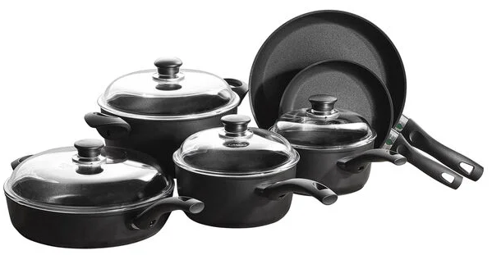
81% OFF
MSRP. $800
NOW $150
BALLARINI Rialto
10 Pcs Cookware set
Forged aluminum construction: Varying thicknesses for optimal heat distribution.
Durable non-stick coating: Ceramic-reinforced, metal utensil safe, PFOA-free.
Thermopoint technology: Handle turns red when hot, green when safe.
Oven safe: Up to 160°C/320°F; dishwasher safe.
Item No. 1020272/75003-371

Slide 23
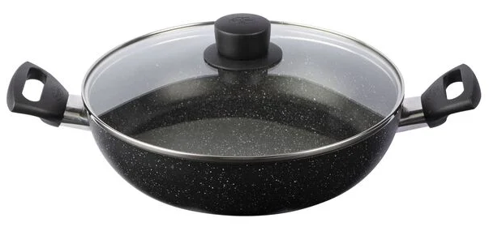
72% OFF
MSRP. $160
NOW $45
BALLARINI Vipiteno
Round Saucier with Lid
Nerolite coating: Scratch-resistant, non-stick, low-oil frying.
Radiant Induction base: Rapid, uniform heat distribution.
Ergonomic handle: Cool-touch plastic handle.
Induction-compatible: Suitable for all stove types.
Item No. 1022756/75003-522

Slide 24
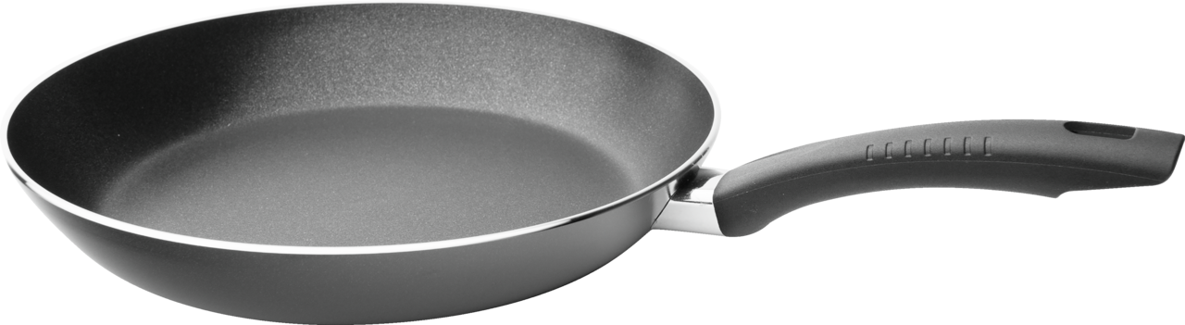
72% OFF
MSRP. $36
NOW $10
BALLARINI
Fry pan 20 black round aluminium
Item No. 1006725/75001-607

Slide 25
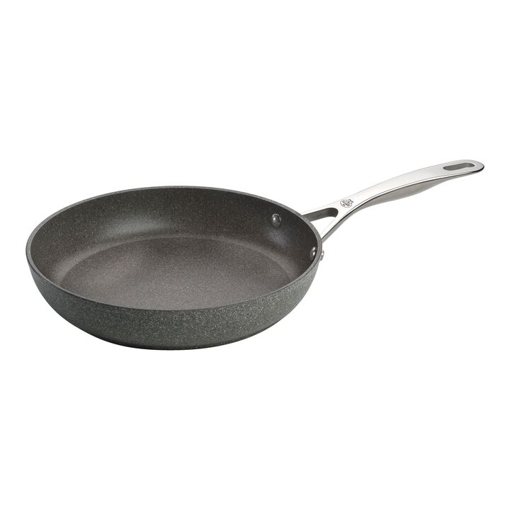
84% OFF
MSRP. $250
NOW $40
BALLARINI SALINA
28 cm / 11 inch aluminum Frying pan
Suitable for everyday boiling, frying, braising and cooking
Stainless steel handle remains cool when cooking
Cookware suitable for use in ovens
Designed in Milan by Studio Matteo Thun & Antonio Rodriguez
Extra layer of titanium
Item No. 1007043/75002-822-0

Slide 26
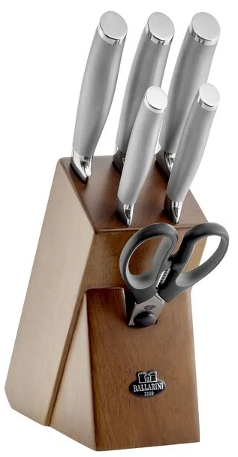
83% OFF
MSRP. $404
NOW $70
BALLARINI Tanaro
7 Pcs, Knife Block Set
7-piece set: Includes 8" chef's knife, 8" bread knife, 6" carving knife, 5" utility knife, 3.5" paring knife, and kitchen scissors.
German stainless-steel blades: Sharp, corrosion-resistant, excellent cutting edge.
Elegant design: Matte and polished stainless-steel handles.
Item No. 1001041/18560-007

Slide 27
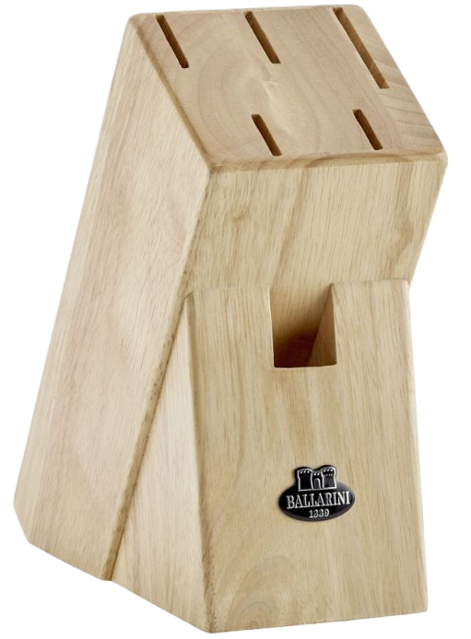
75% OFF
MSRP. $60
NOW $15
BALLARINI
Knife Block, Empty
Wooden knife block: Protects blades from bumps and scratches.
Safe storage: Holds 5 knives and 1 pair of shears.
Material: Made from durable rubberwood.
Compact design: Small and space-efficient.
Item No. 1001055/18600-100

Slide 28

64% OFF
MSRP. $50
NOW $18
1025117
BALLARINI SPECIALS
SILICONE PAN PROTECTORS
Item No. 1018329/75002-906

Slide 29
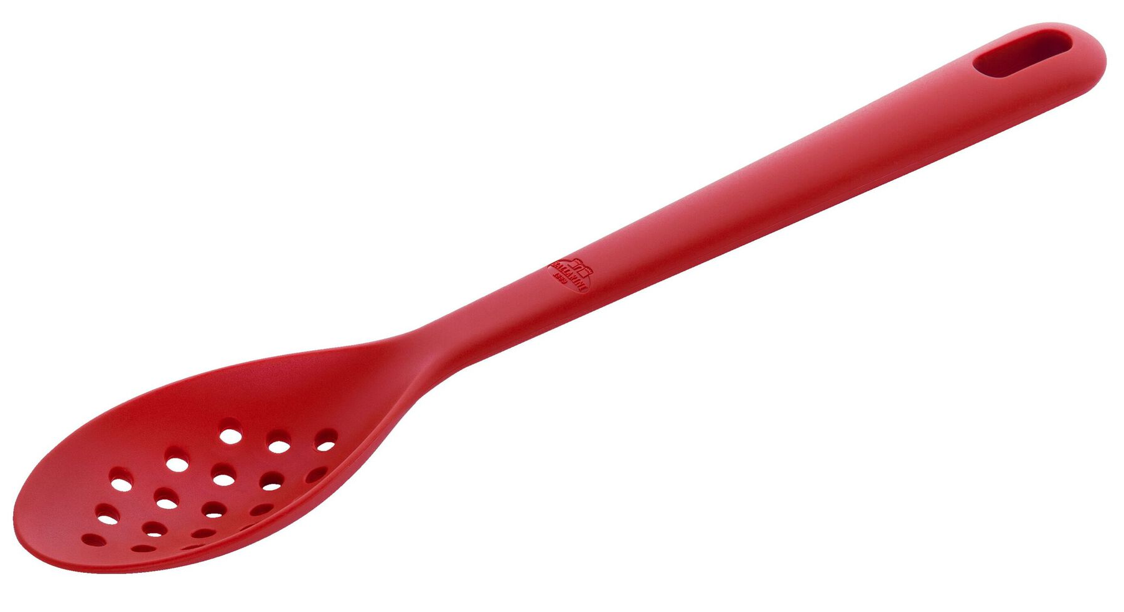
58% OFF
MSRP. $19
NOW $8
BALLARINI Rosso
Skimming Spoon, 31 cm
Compact skimming spoon: Ideal for removing pasta, vegetables, and impurities from cooking liquids.
Heat-resistant: Safe up to 230°C/445°F.
Dishwasher safe: Easy to clean.
Ergonomic handle: Designed by Matteo Thun; non-slip and comfortable.
Item No. 1001156/28000-012

Slide 30
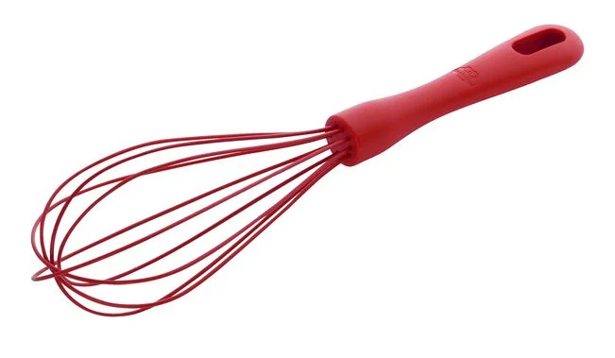
58% OFF
MSRP. $19
NOW $8
BALLARINI Rosso
Whisk, 29cm, Silicone
Function: Ideal for mixing and whisking, perfect for sauces, egg whites, and drinks.
Material: High-quality, heat-resistant silicone (up to 230°C/445°F).
Design: Ergonomic, non-slip handle for comfortable use
Care: Dishwasher safe, not microwave safe.
Item No. 1001151/28000-007

Slide 31
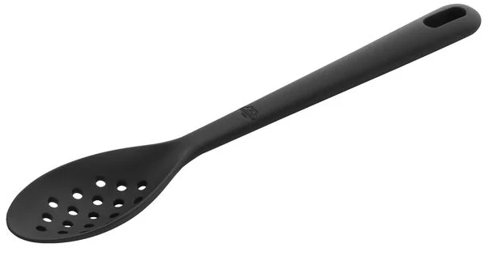
50% OFF
MSRP. $16
NOW $8
BALLARINI Nero
Skimming spoon, 31cm, Silicone
Versatile use: Skims soups, removes vegetables, and stirs thick sauces.
Durable silicone: Scratch-resistant, heatproof up to 230°C/445°F.
Ergonomic grip: Secure, comfortable handle with a hanging hole.
Easy to clean: Dishwasher-safe, not microwave-safe.
Item No. 1001169/28001-012

Slide 32
67% OFF
MSRP. $24
NOW $8
BALLARINI Nero
31 cm Silicone Skimming ladle
Versatile use: Lifts food from hot water or fat, and skims impurities from soups and sauces.
Durable silicone: Scratch-resistant, heatproof up to 230°C/445°F.
Ergonomic grip: Secure, comfortable handle with a hanging hole.
Easy to clean: Dishwasher-safe, not microwave-safe.
Item No. 1001159/28001-002

Slide 33
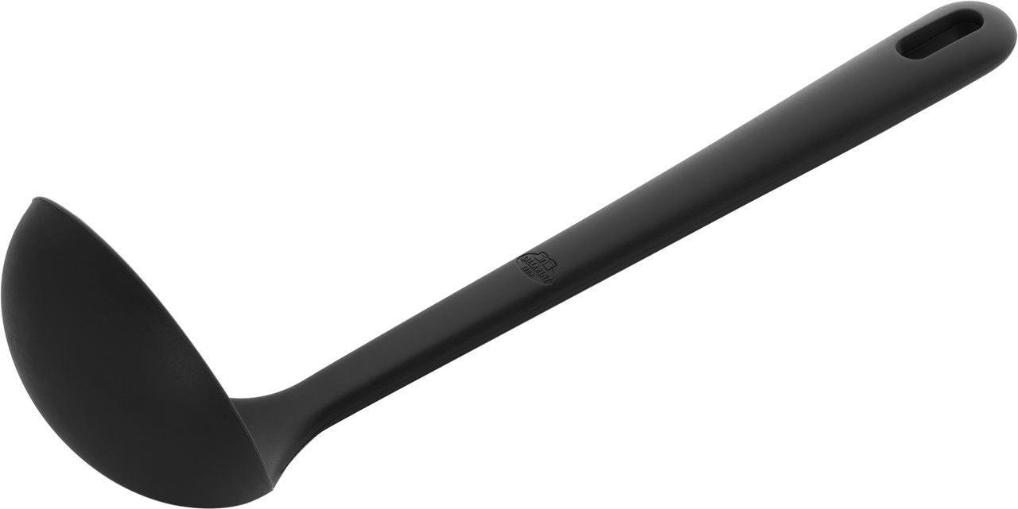
71% OFF
MSRP. $24
NOW $7
BALLARINI NERO
Soup Ladle
Item No. 1001158/28001-001

Slide 34
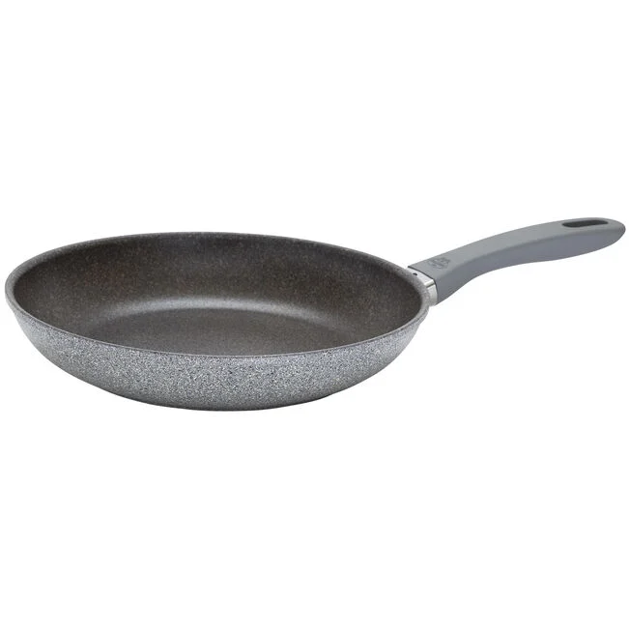
56% OFF
MSRP. $80
NOW $35
BALLARINI PARMA PLUS
26cm Fry Pan
The ultimate non-stick pan
Ultra-thick aluminum body - quick and even heating
Thermopoint heat indicator for energy saving cooking
Granitium extreme coating - 5 layer reinforced non stick and scratch resistant
Item No.
1018380/75003-094-0

Slide 35
60% OFF
MSRP. $100
NOW $40
BALLARINI PARMA PLUS
30cm Fry Pan
The ultimate non-stick pan​
Ultra-thick aluminum body - quick and even heating​
Thermopoint heat indicator for energy saving cooking​
Granitium extreme coating - 5 layer reinforced non stick and scratch resistant
Item No.
1018381/75003-095-0

Slide 36
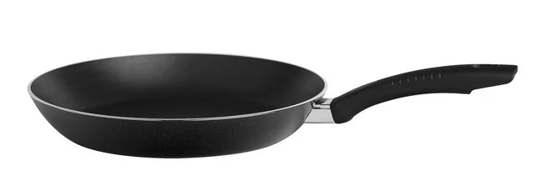
67% OFF
MSRP. $30
NOW $10
BALLARINI siena
16cm Aluminum Frying Pan
Durable Non-Stick Performance: Solid aluminum construction with high scratch and wear resistance, ideal for everyday cooking
Safety and Convenience: Stay-cool handle is ovenproof up to 160°C and easy to clean
Made in Italy
Item No. 1006465/75000-481

Slide 37
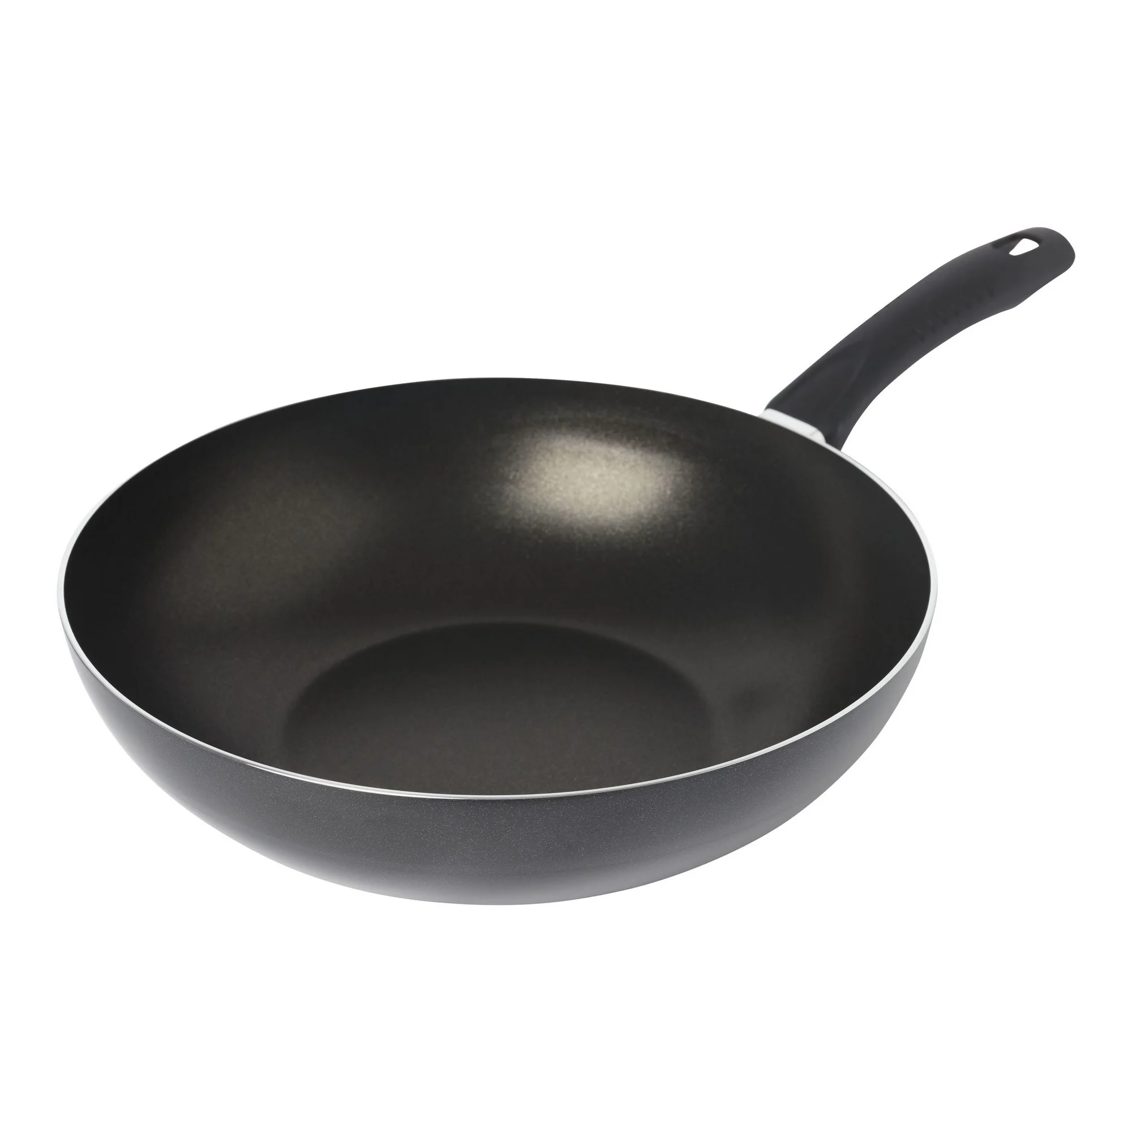
68% OFF
MSRP. $60
NOW $19
BALLARINI siena
28cm Round Wok Black
Durable Non-Stick Performance: Solid aluminum construction with high scratch and wear resistance, ideal for everyday cooking
Safety and Convenience: Stay-cool handle is ovenproof up to 160°C and easy to clean
Made in Italy
Item No.
1006433/75000-319-0

Slide 38
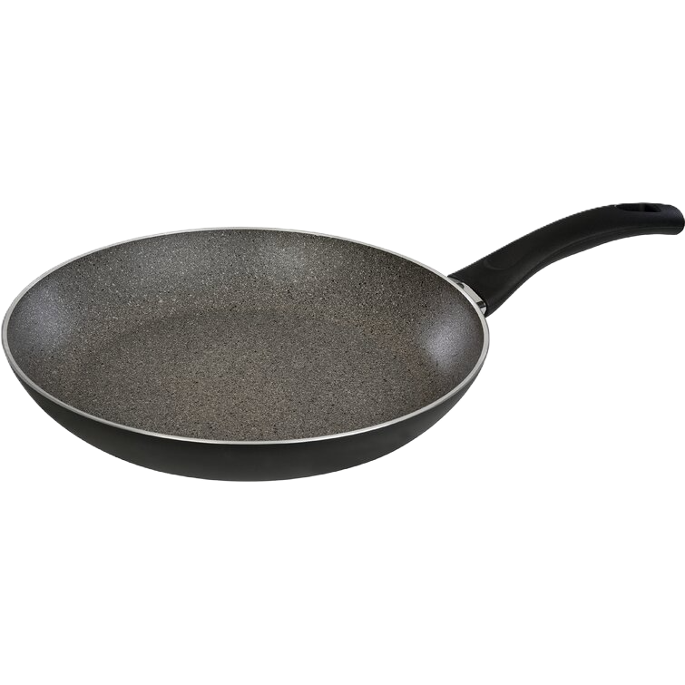
75% OFF
MSRP. $100
NOW $25
BALLARINI BOLOGNA
20cm Granitium Fry Pan Black
Handles: Ergonomic, heat-insulating, soft-touch grip.
Nonstick: 5-layer scratch-resistant GRANITIUM coating.
Performance: Quick, even heating on all stovetops, including induction.
Thermopoint: Indicator signals optimal cooking temperature.
Made in Italy
Item No.
1006541/75000-631-0

Slide 39
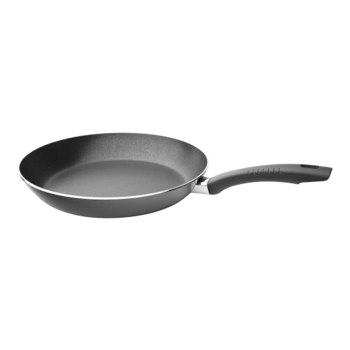
57% OFF
MSRP. $46
NOW $20
BALLARINI SIENA
24cm Fry Pan Black
Durable Non-Stick Performance: Solid aluminum construction with high scratch and wear resistance, ideal for everyday cooking
Safety and Convenience: Stay-cool handle is ovenproof up to 160°C and easy to clean
Made in Italy
Item No.
1006726/75001-608-0

Slide 40
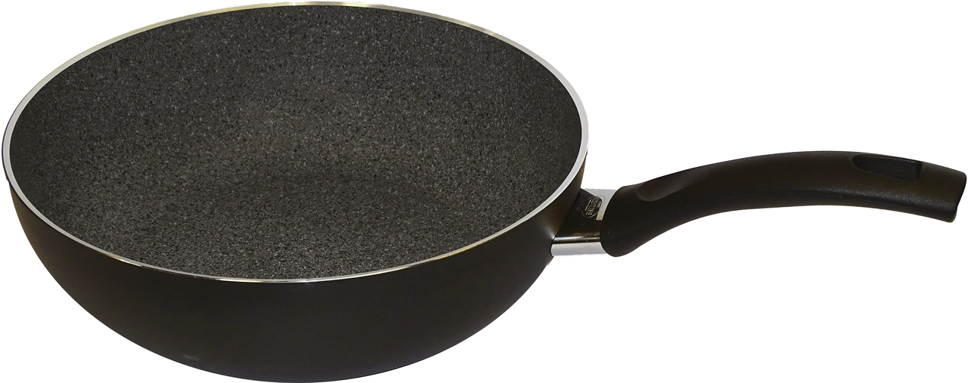
67% OFF
MSRP. $120
NOW $40
BALLARINI Bologna Granitium
28cm Aluminum PTFE Wok
Durable Non-Stick Coating: Scratch-resistant Granitium coating with extreme resistance and non-stick forged construction
Innovative Technology: Patented Thermopoint technology ensures perfect temperature cooking Made in Italy
Item No. 1008127/75003-055

Slide 41
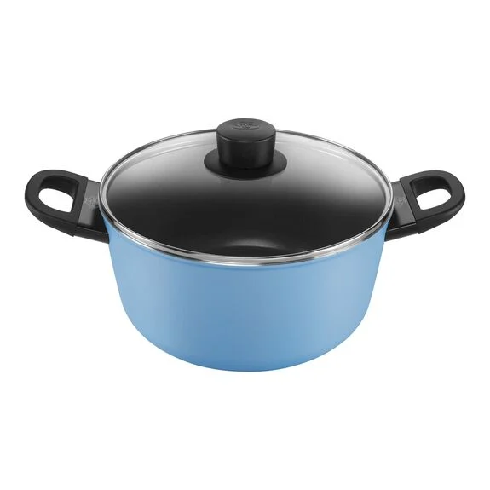
77% OFF
MSRP. $200
NOW $60
BALLARINI Caprera
4.75L STEW POT
Stylish design: Bright blue Stew Pot.
KERA GLOSS coating: Non-stick, crispy results.
Radiant induction base: Fast, even heating.
Tight-fitting lid for energy-efficient cooking
Induction-compatible.
Item No. 1025108

